Slide 1
GIT HUB Branching & Merging
Presented by Adam, Justin, Kalin & Ashley

Slide 2
Basic Git Commands
Git Commands
git init
git clone <repo URL>
git Status
git add –A
git add .
git add -u
git add <file-name>
git commit –m’some comment’
git push
git pull
What They Do
Initializes Repo
Clones the repo to a location
Gets the current branch status
Adds ALL files to the staging area
Without deleted
Without new
Adds the specified file to stage
Commits all staged files
Pushes the changes to GitHub
Grabs any changes from GitHub

Slide 3
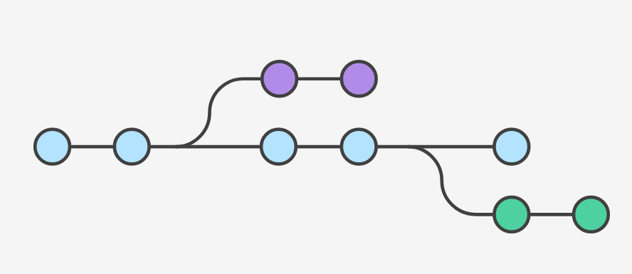
GIT BRANCH
Think of them as a way to request a brand new working directory, staging area, and project history.
Makes sure that unstable code is never committed to the main code base
Clean up feature’s history before merging it into the main branch.

Slide 4
Git Branchy
Common Git Branch Commands
git branch
git branch <branch-Name>
git checkout ‘branch-Name’
git branch -d <branch-Name>
git branch –D <branch-Name>
What it means
List all branches
Makes the new branch
Switch to named branch
Safely Delete the named branch
Non safe way to delete branch

Slide 5
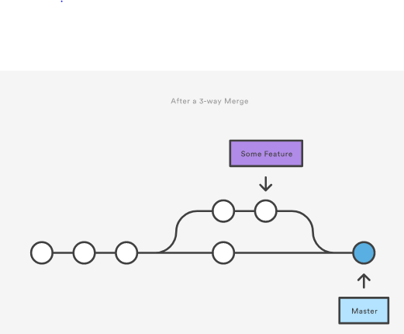
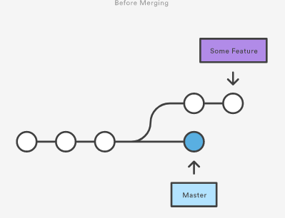
GIT Merge
The git merge command lets you take the independent lines of development created by git branch and integrate them into a single branch.

Slide 6
Git Mergey
Common Git Merge Commands
git branch
git branch <branch-name>
git merge <branch-name>
git Status
Handy for dealing with conflicts
What They Do
List all branches
Creates a new branch
Merges named branch to current branch
Shows status of current branch

Slide 7
Branching with GitKraken
Simply right click on your local master branch and select ‘Create branch here‘.
Type the name of your new branch when prompted to do so.
You can now begin working on your branch files just as you would the master. As you add or change your files you can stage, commit, and push the changes.

Slide 8
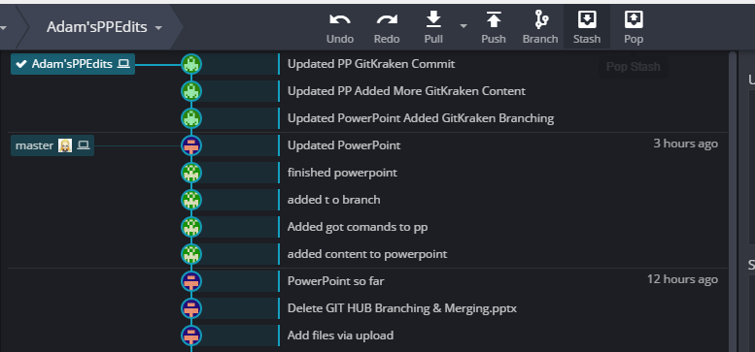
GitKraken Graphical View (What you are seeing is Adam’sPPEdits branch and the 3 commits I have made since I branched off of the master.)

Slide 9
Merging with GitKraken
Merging takes differences from another branch, and apply them to whichever branch you are currently working on.
This is accomplished by dragging one local branch into another branch. It should open a menu, from which you want to select ‘Merge branchX into branchY.

Slide 10
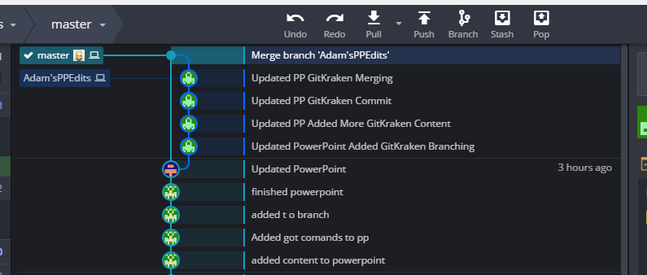
GitKraken Graphical View (What you are seeing is Adam’sPPEdits branch merging back into the master branch.)

Slide 11
That’s all folks!
Now lets all try it for ourselves.

